Slide 1
Look and Live
2024 Quarter 4 Lesson 4

Slide 2
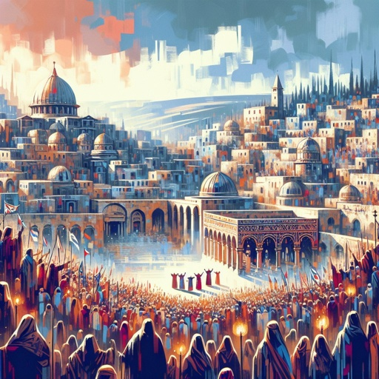
He knew all men - John 2:23
Now when he was in Jerusalem at the passover, in the feast day, many believed in his name, when they saw the miracles which he did.
“Jesus knew the character of the ones who came to Him and read their hearts as an open book.” - Desire of Ages, p. 167

Slide 3
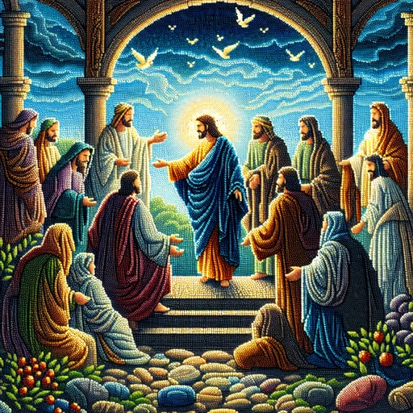
He knew all men - John 2:24
But Jesus did not commit himself unto them, because he knew all men,
“His look seemed to search deeply beneath the surface, yet He spoke with great kindness.” - Desire of Ages, p. 171

Slide 4
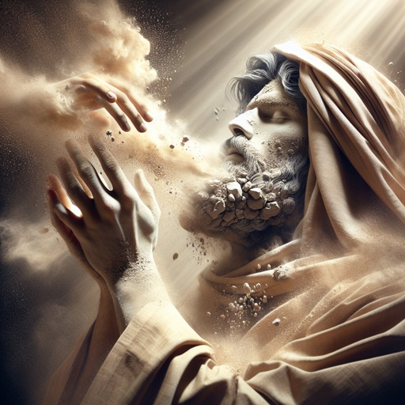
He knew all men - John 2:25
And needed not that any should testify of man: for he knew what was in man.
“Now when they asked for a sign, He answered them by a parable, showing that He read their malice, and saw to what lengths it would lead them.” - Desire of Ages, p. 164

Slide 5
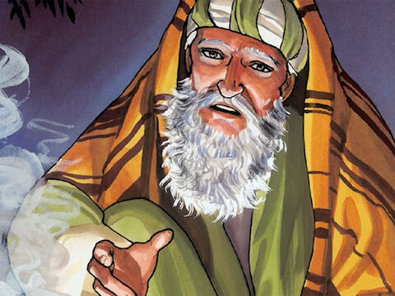
He knew all men - John 3:1
There was a man of the Pharisees, named Nicodemus, a ruler of the Jews:
“Nicodemus held a high position of trust in the Jewish nation. He was highly educated, and possessed talents of no ordinary character…” - Desire of Ages, p. 167

Slide 6
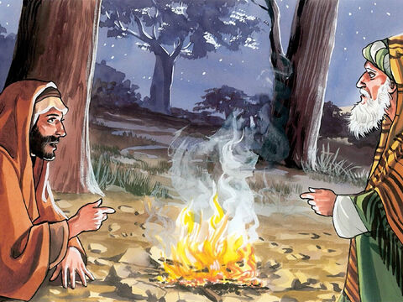
Born again - John 3:2
The same came to Jesus by night, and said unto him, Rabbi, we know that thou art a teacher come from God: for no man can do these miracles that thou doest, except God be with him.
“Nicodemus needed a new heart, one formed through God's Spirit.” - Desire of Ages, p. 172

Slide 7
Born again - John 3:3
Jesus answered and said unto him, Verily, verily, I say unto thee, Except a man be born again, he cannot see the kingdom of God.
“Christ did not fail to speak of man’s sin, but offered the remedy in new life.” - Desire of Ages, p. 173

Slide 8
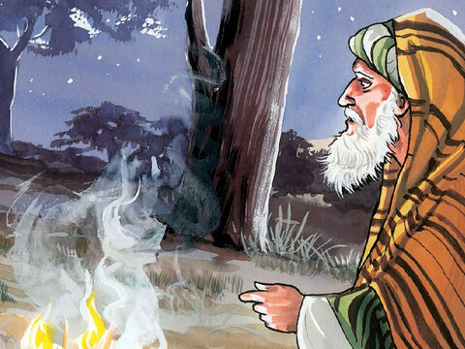
Born again - John 3:4
Nicodemus saith unto him, How can a man be born when he is old? can he enter the second time into his mother's womb, and be born?
“Nicodemus had come to the Lord thinking to enter into a discussion with Him, but Jesus laid bare the foundation principles of truth.- Desire of Ages, p. 172

Slide 9
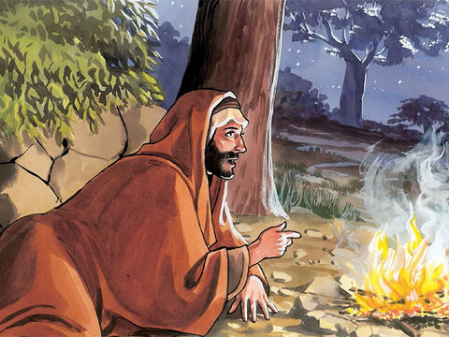
Born again - John 3:5
Jesus answered, Verily, verily, I say unto thee, Except a man be born of water and of the Spirit, he cannot enter into the kingdom of God.
“He said to Nicodemus, It is not theoretical knowledge you need so much as spiritual regeneration. You need not to have your curiosity satisfied, but to have a new heart. - Desire of Ages, p. 173

Slide 10
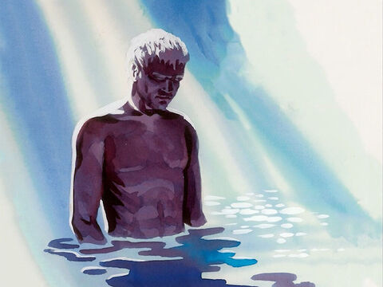
Born again - John 3:6
That which is born of the flesh is flesh; and that which is born of the Spirit is spirit.
“The Christian's life is not a modification or improvement of the old, but a transformation of nature. There is a death to self and sin, and a new life altogether.” - Desire of Ages, p. 172

Slide 11
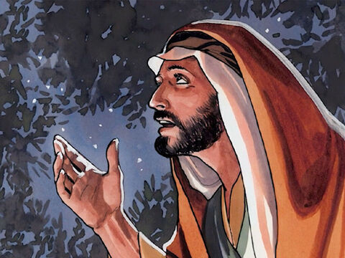
Born again - John 3:7
Marvel not that I said unto thee, Ye must be born again.
“The pride of the Pharisee was struggling against the honest desire of the seeker after truth. He wondered that Christ should speak to him as He did....” - Desire of Ages, p. 171

Slide 12
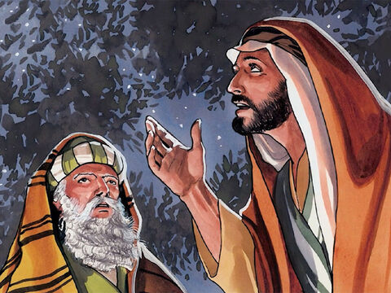
Born again - John 3:8
The wind bloweth where it listeth, and thou hearest the sound thereof, but canst not tell whence it cometh, and whither it goeth: so is every one that is born of the Spirit.
“By an agency as unseen as the wind, Christ is constantly working upon the heart. ” - Desire of Ages, p. 172

Slide 13
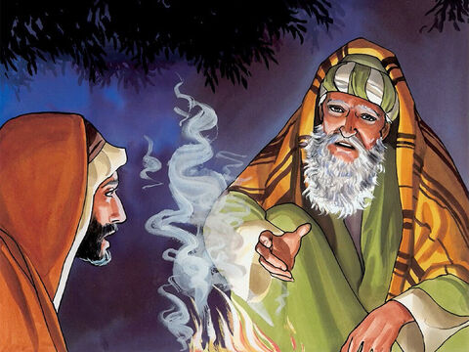
Born again - John 3:9
Nicodemus answered and said unto him, How can these things be?
“He was not so much impressed by the necessity of the new birth as by the manner of its accomplishment. ” - Desire of Ages, p. 173

Slide 14
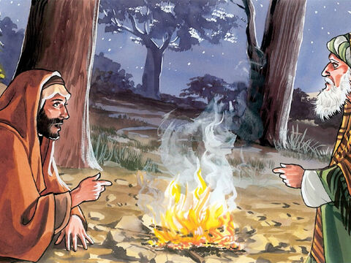
Look up and live - John 3:10
Jesus answered and said unto him, Art thou a master of Israel, and knowest not these things?
“His words conveyed the lesson that instead of feeling irritated over the plain words of truth, Nicodemus should have had a very humble opinion of himself, because of his spiritual ignorance.”- Desire of Ages, p. 173

Slide 15
Look up and live - John 3:11
Verily, verily, I say unto thee, We speak that we do know, and testify that we have seen; and ye receive not our witness.
“The Jews whom Jesus had driven from the temple claimed to be children of Abraham, but …they could not endure the glory of God which was manifested in Him.” - Desire of Ages, p. 174

Slide 16
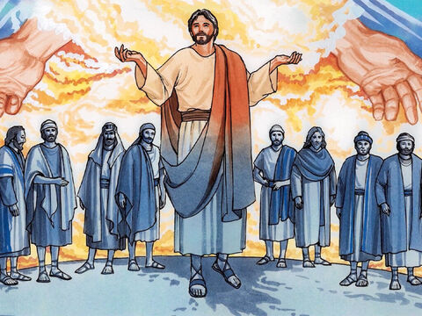
Look up and live - John 3:12
If I have told you earthly things, and ye believe not, how shall ye believe, if I tell you of heavenly things?
“If Nicodemus could not receive Christ's teaching, illustrating the work of grace upon the heart, how could he comprehend the nature of His glorious heavenly kingdom? .” - Desire of Ages, p. 174

Slide 17
Look up and live - John 3:13
And no man hath ascended up to heaven, but he that came down from heaven, even the Son of man which is in heaven.
“Their great need was that very change which Christ had been explaining to Nicodemus,—a new moral birth, a cleansing from sin, and a renewing of knowledge and holiness.- Desire of Ages, p. 174

Slide 18
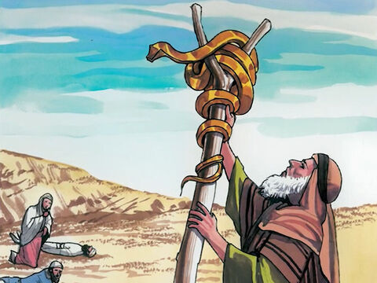
Look up and live - John 3:14
And as Moses lifted up the serpent in the wilderness, even so must the Son of man be lifted up:
“As the Saviour explained to him concerning the new birth, he longed to have this change wrought in himself. By what means could it be accomplished?” - Desire of Ages, p. 174

Slide 19
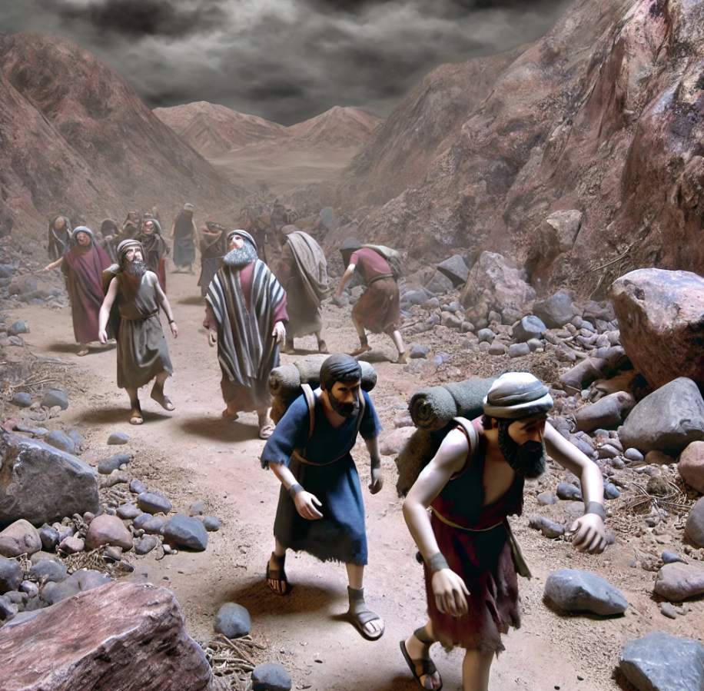
Look up and live
– Numbers 21:4
4 And they journeyed from mount Hor by the way of the Red sea, to compass the land of Edom: and the soul of the people was much discouraged because of the way.

Slide 20
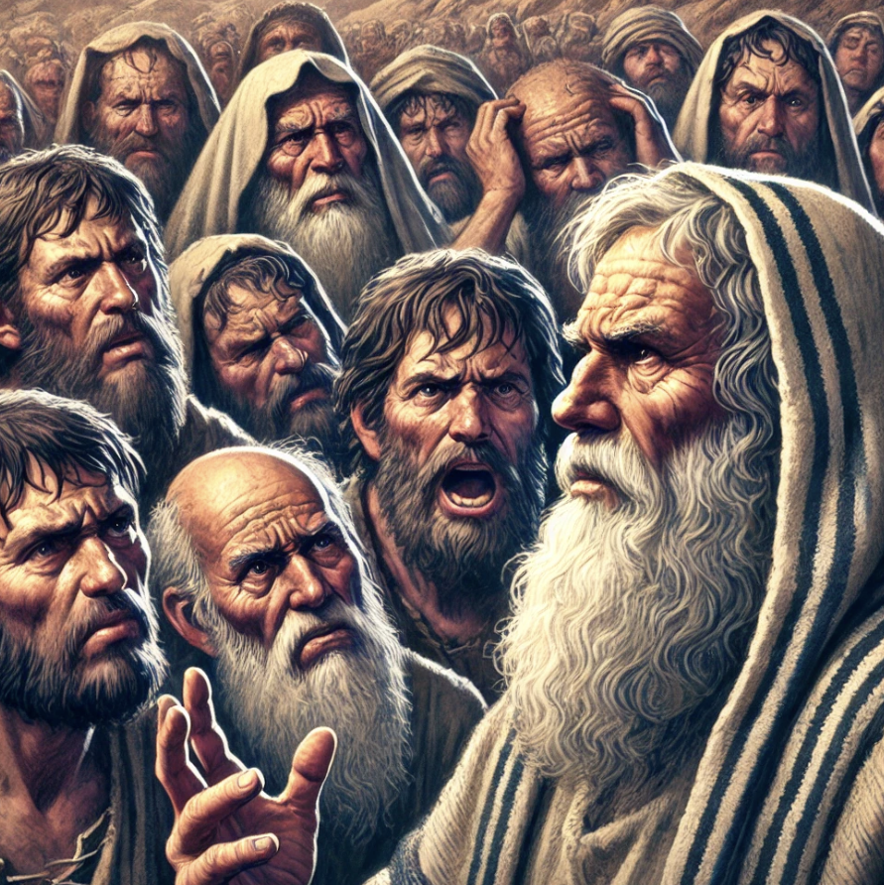
Look up and live
– Numbers 21:5
5 And the people spake against God, and against Moses, Wherefore have ye brought us up out of Egypt to die in the wilderness? for there is no bread, neither is there any water; and our soul loatheth this light bread.

Slide 21

Look up and live
– Numbers 21:6
6 And the Lord sent fiery serpents among the people, and they bit the people; and much people of Israel died.

Slide 22
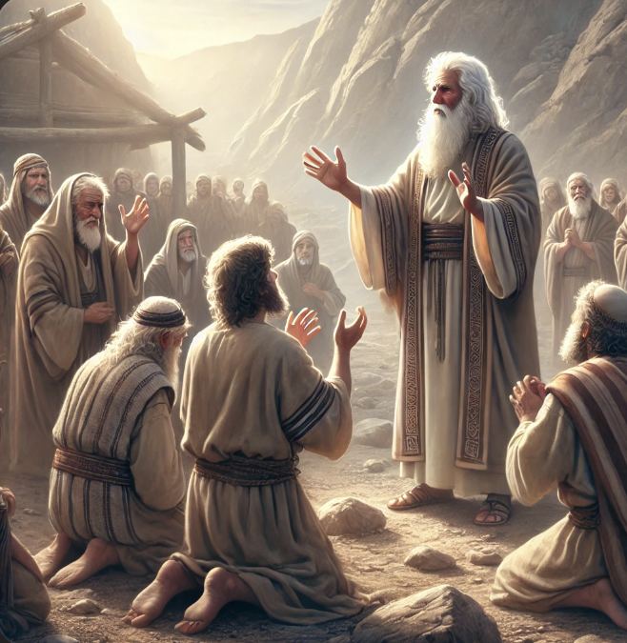
Look up and live
– Numbers 21:7
7 Therefore the people came to Moses, and said, We have sinned, for we have spoken against the Lord, and against thee; pray unto the Lord, that he take away the serpents from us. And Moses prayed for the people.

Slide 23
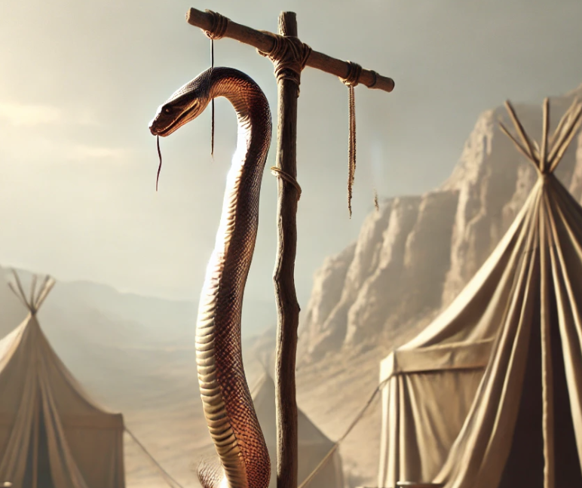
Look up and live
– Numbers 21:8
8 And the Lord said unto Moses, Make thee a fiery serpent, and set it upon a pole: and it shall come to pass, that every one that is bitten, when he looketh upon it, shall live.

Slide 24

Look up and live
– Numbers 21:9
9 And Moses made a serpent of brass, and put it upon a pole, and it came to pass, that if a serpent had bitten any man, when he beheld the serpent of brass, he lived.

Slide 25
Look up and live - John 3:15
That whosoever believeth in him should not perish, but have eternal life.
“Christ’s love reaches down to the depths to lift up the perishing.” - Desire of Ages, p. 176

Slide 26
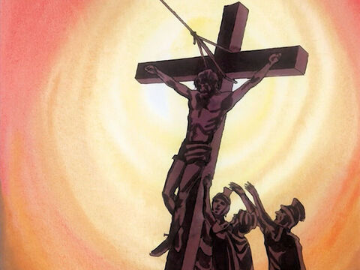
Look up and live - John 3:16
For God so loved the world, that he gave his only begotten Son, that whosoever believeth in him should not perish, but have everlasting life.
“They might have demanded a scientific explanation. But no explanation was given. They must accept the word of God to them through Moses. To refuse to look was to perish.”- Desire of Ages, p. 175

Slide 27
Look up and live - John 3:17
For God sent not his Son into the world to condemn the world; but that the world through him might be saved.
“There are thousands today who need to learn the same truth that was taught to Nicodemus by the uplifted serpent.” - Desire of Ages, p. 175

Slide 28
Look up and live - John 3:18
He that believeth on him is not condemned: but he that believeth not is condemned already, because he hath not believed in the name of the only begotten Son of God.
“The light shining from the cross reveals the love of God. His love is drawing us to Himself.” - Desire of Ages, p. 176

Slide 29
Look up and live - John 3:19
And this is the condemnation, that light is come into the world, and men loved darkness rather than light, because their deeds were evil.
“If we do not resist this drawing, we shall be led to the foot of the cross in repentance for the sins that have crucified the Saviour.”
- Desire of Ages, p. 176

Slide 30
Look up and live - John 3:20
For every one that doeth evil hateth the light, neither cometh to the light, lest his deeds should be reproved.
“Then the Spirit of God through faith produces a new life in the soul.” - Desire of Ages, p. 176

Slide 31
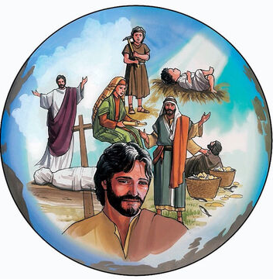
Look up and live - John 3:21
But he that doeth truth cometh to the light, that his deeds may be made manifest, that they are wrought in God.
“The thoughts and desires are brought into obedience to the will of Christ. The heart, the mind, are created anew in the image of Him who works in us to subdue all things to Himself.” - Desire of Ages, p. 176

Slide 32
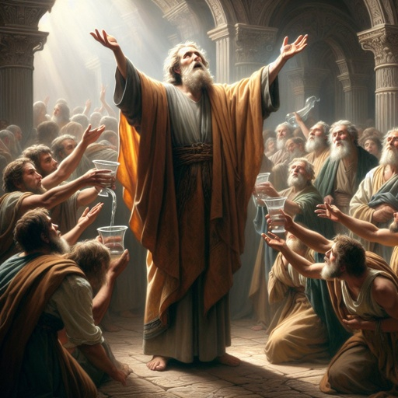
Let him come unto me
- John 7:37
In the last day, that great day of the feast, Jesus stood and cried, saying, If any man thirst, let him come unto me, and drink.
“With the great day of the feast, Jesus spoke of the water of life.” - Desire of Ages, p. 177

Slide 33
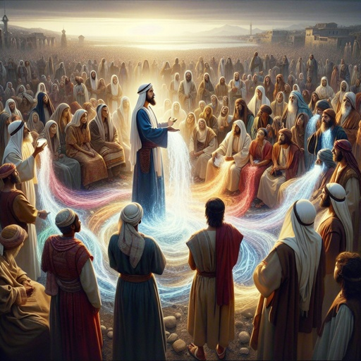
Let him come unto me
- John 7:38
He that believeth on me, as the scripture hath said, out of his belly shall flow rivers of living water.
“All who feel their need of Christ may come and drink freely.” - Desire of Ages, p. 181

Slide 34

Let him come unto me
- John 7:39
(But this spake he of the Spirit, which they that believe on him should receive: for the Holy Ghost was not yet given; because that Jesus was not yet glorified.)
“There is a death to self and sin, and a new life altogether. This change can be brought about only by the effectual working of the Holy Spirit.” - Desire of Ages, p. 172

Slide 35
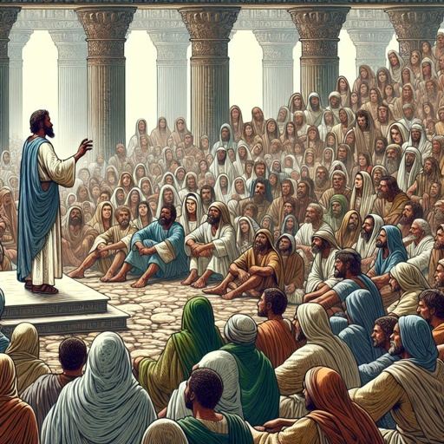
Let him come unto me
- John 7:40
Many of the people therefore, when they heard this saying, said, Of a truth this is the Prophet.
“While Jesus was speaking, some gleams of truth penetrated the ruler's mind. The softening, subduing influence of the Holy Spirit impressed his heart.” - Desire of Ages, p. 173

Slide 36

Let him come unto me
- John 7:41
Others said, This is the Christ. But some said, Shall Christ come out of Galilee?
“It is impossible for finite minds to comprehend the work of redemption. Its mystery exceeds human knowledge; yet he who passes from death to life realizes that it is a divine reality.”- Desire of Ages, p. 173

Slide 37
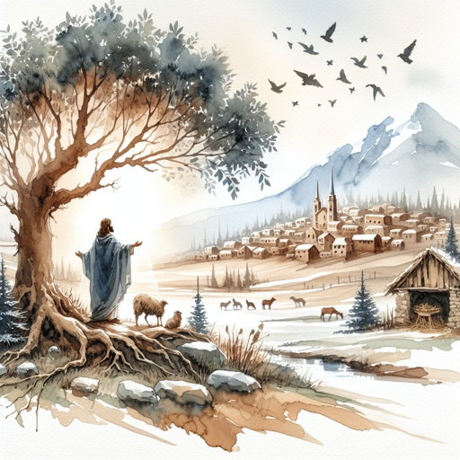
Let him come unto me
- John 7:42
Hath not the scripture said, That Christ cometh of the seed of David, and out of the town of Bethlehem, where David was?
“The beginning of redemption we may know here through a personal experience. Its results reach through the eternal ages.” - Desire of Ages, p. 173

Slide 38
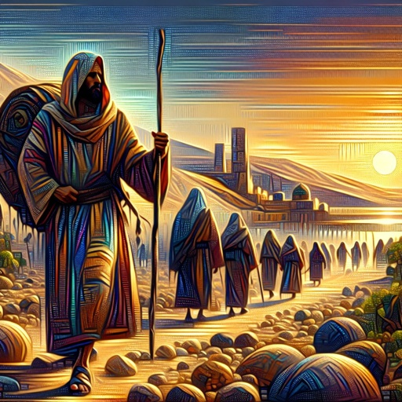
Let him come unto me
- John 7:43
So there was a division among the people because of him.
“No one sees the hand that lifts the burden, or beholds the light descend from the courts above. The blessing comes when by faith the soul surrenders itself to God.” - Desire of Ages, p. 173

Slide 39
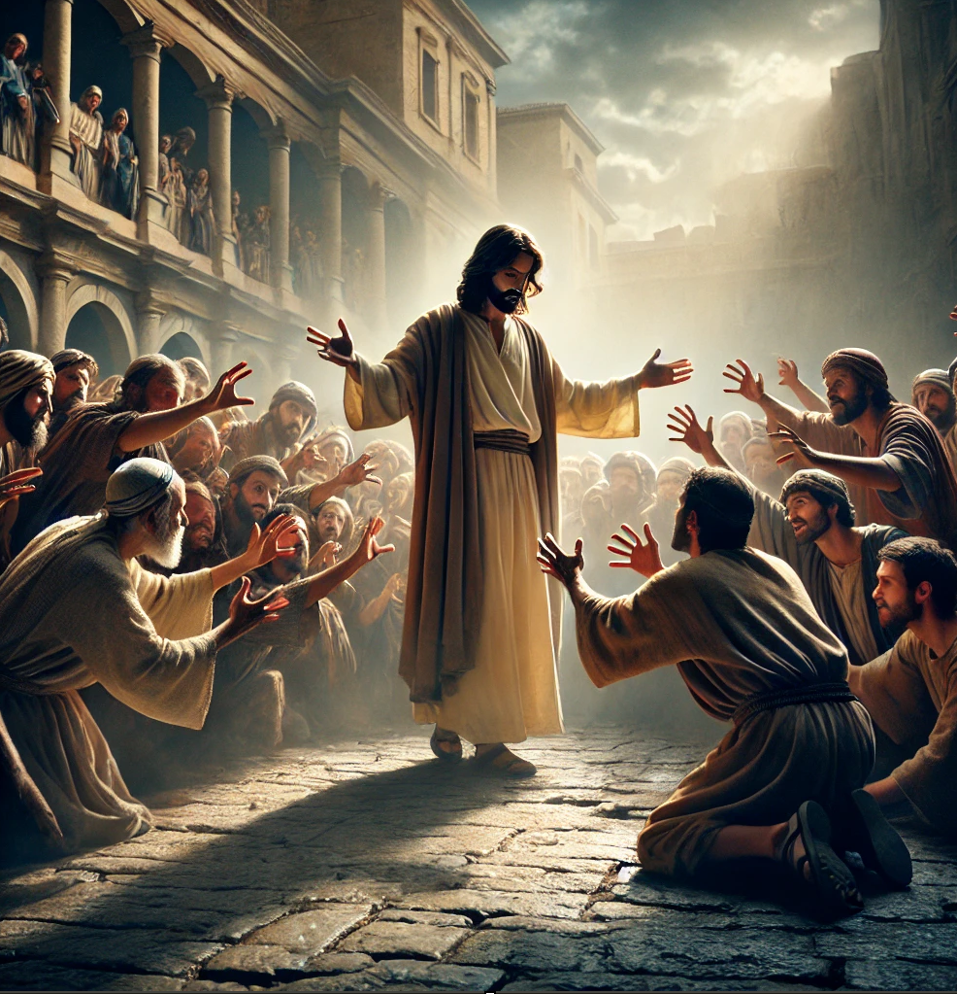
Deceived - John 7:44
And some of them would have taken him; but no man laid hands on him.
“The leaders refused to believe and sought to discredit His words.” - Desire of Ages, p. 182

Slide 40
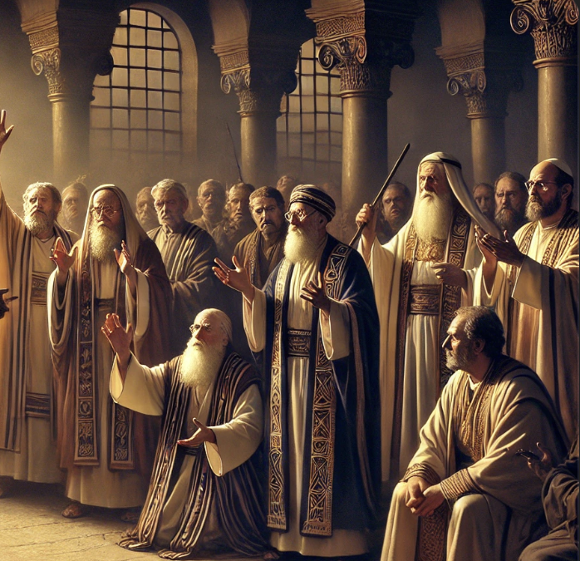
Deceived - John 7:45
Then came the officers to the chief priests and Pharisees; and they said unto them, Why have ye not brought him?
“True understanding comes to those who are willing to listen to truth.” - Desire of Ages, p. 183

Slide 41
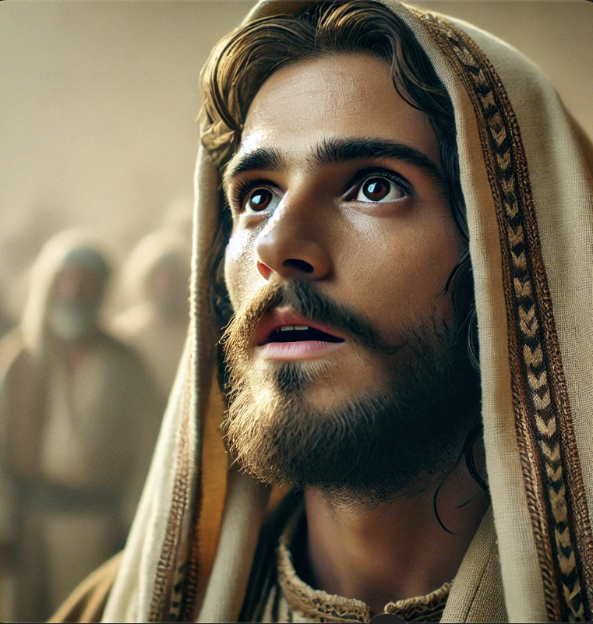
Deceived - John 7:46
The officers answered, Never man spake like this man.
“There was no excuse for the blindness of Israel in regard to the work of regeneration. - Desire of Ages, p. 184

Slide 42
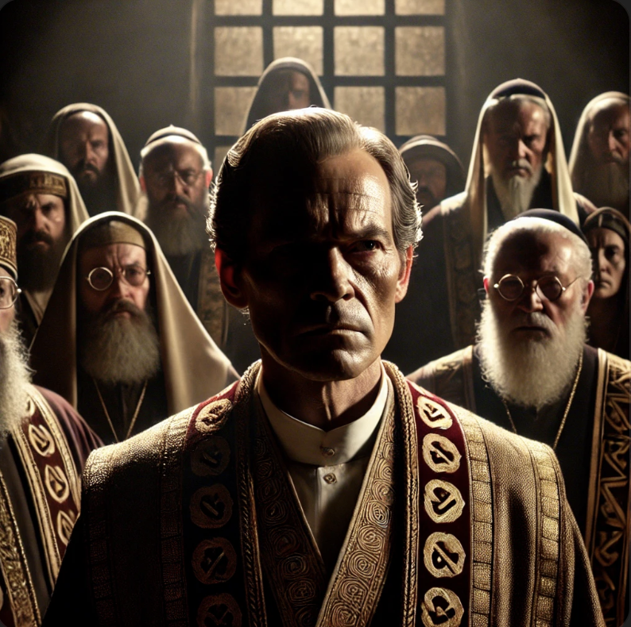
Deceived - John 7:47
Then answered them the Pharisees, Are ye also deceived?
“True understanding comes to those who are willing to listen to truth.” - Desire of Ages, p. 183

Slide 43
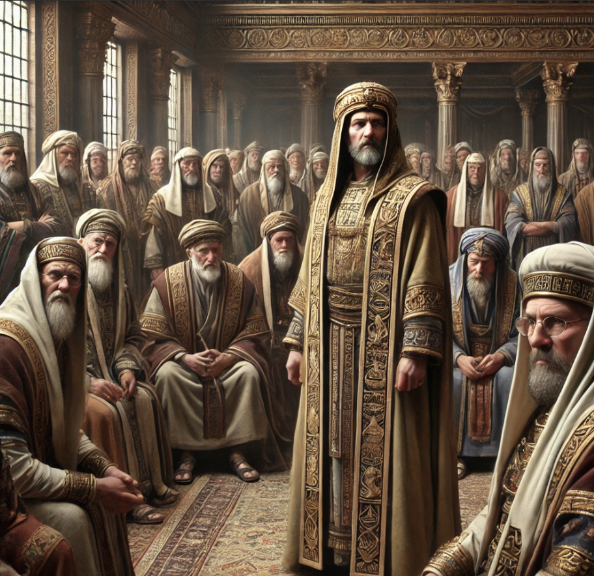
Deceived - John 7:48
Have any of the rulers or of the Pharisees believed on him?
“The work of God is not to bear the image and superscription of man. From time to time the Lord will bring in different agencies, through whom His purpose can best be accomplished. “- Desire of Ages, p. 182

Slide 44
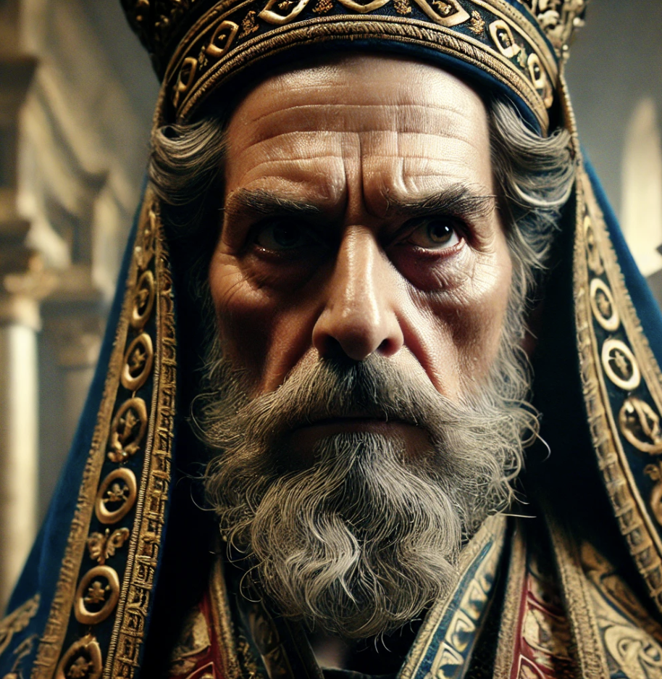
Deceived - John 7:49
But this people who knoweth not the law are cursed.
“The people are taught to rely on man for guidance, and thus they fall into error, and are led away from God.” - Desire of Ages, p. 182

Slide 45
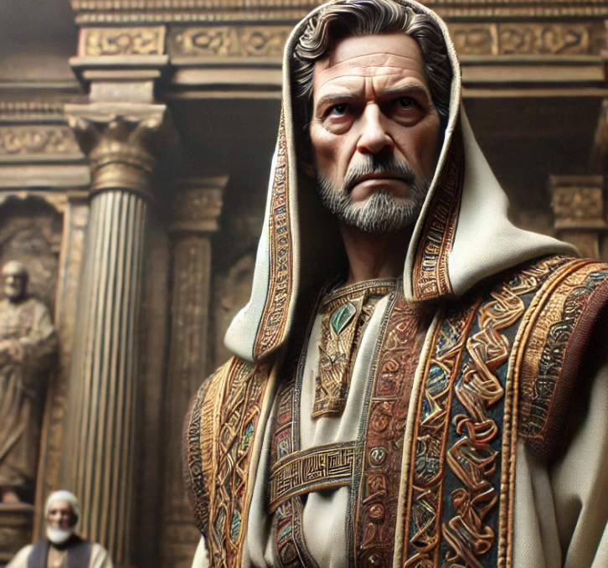
Deceived - John 7:50
Nicodemus saith unto them, (he that came to Jesus by night, being one of them,)
“In the interview with Nicodemus, Jesus unfolded the plan of salvation, and His mission to the world.”- Desire of Ages, p. 176

Slide 46
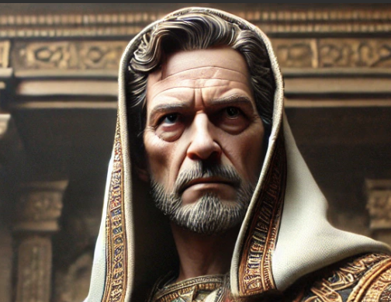
Deceived - John 7:51
Doth our law judge any man, before it hear him, and know what he doeth?
“At the very beginning of His ministry He opened the truth to a member of the Sanhedrin, to the mind that was most receptive, and to an appointed teacher of the people. But the leaders of Israel did not welcome the light.” - Desire of Ages, p. 176

Slide 47
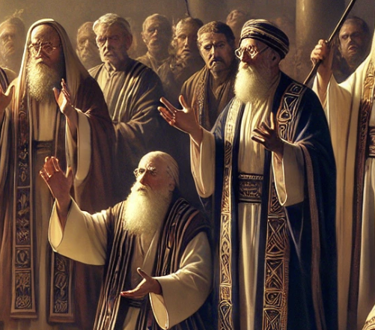
Deceived - John 7:52
They answered and said unto him, Art thou also of Galilee? Search, and look: for out of Galilee ariseth no prophet.
“Nicodemus hid the truth in his heart, and for three years there was little apparent fruit.”- Desire of Ages, p. 176

Slide 48
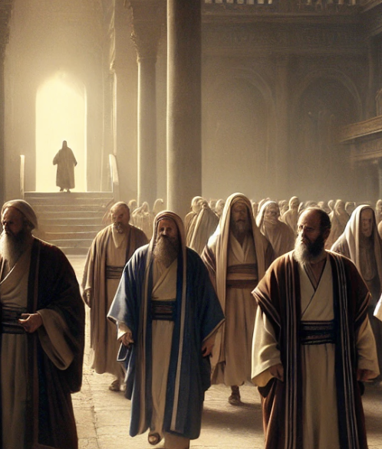
Deceived - John 7:53
And every man went unto his own house.
“But Jesus was acquainted with the soil into which He cast the seed. The words spoken at night to one listener in the lonely mountain were not lost.”- Desire of Ages, p. 176

Slide 49
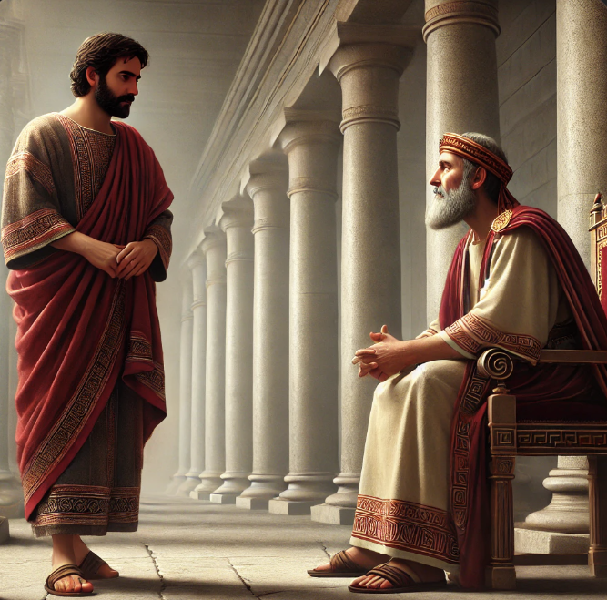
No longer by night
- John 19:38
And after this Joseph of Arimathaea, being a disciple of Jesus, but secretly for fear of the Jews, besought Pilate that he might take away the body of Jesus: and Pilate gave him leave. He came therefore, and took the body of Jesus.
“For a time Nicodemus did not publicly acknowledge Christ, but… he repeatedly thwarted the schemes of the priests to destroy Him.”- Desire of Ages, p. 176

Slide 50
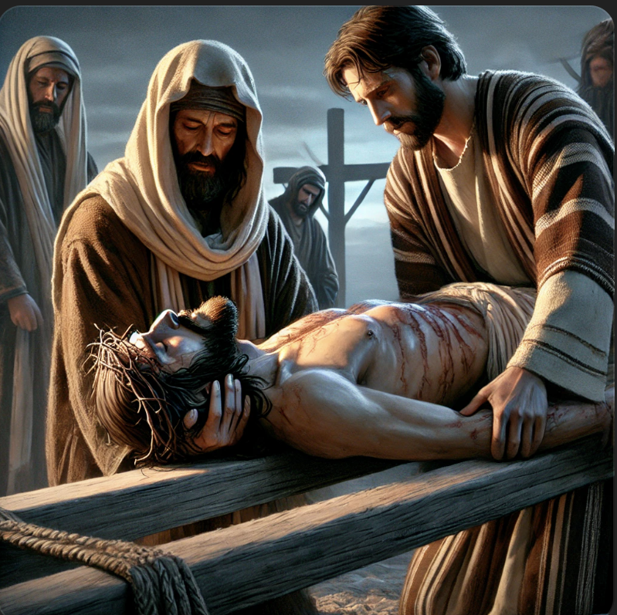
No longer by night
- John 19:39
And there came also Nicodemus, which at the first came to Jesus by night, and brought a mixture of myrrh and aloes, about an hundred pound weight.
“When at last Jesus was lifted up on the cross, Nicodemus remembered … The light from that secret interview illumined the cross upon Calvary, and Nicodemus saw in Jesus the world's Redeemer.” - Desire of Ages, p. 176

Slide 51
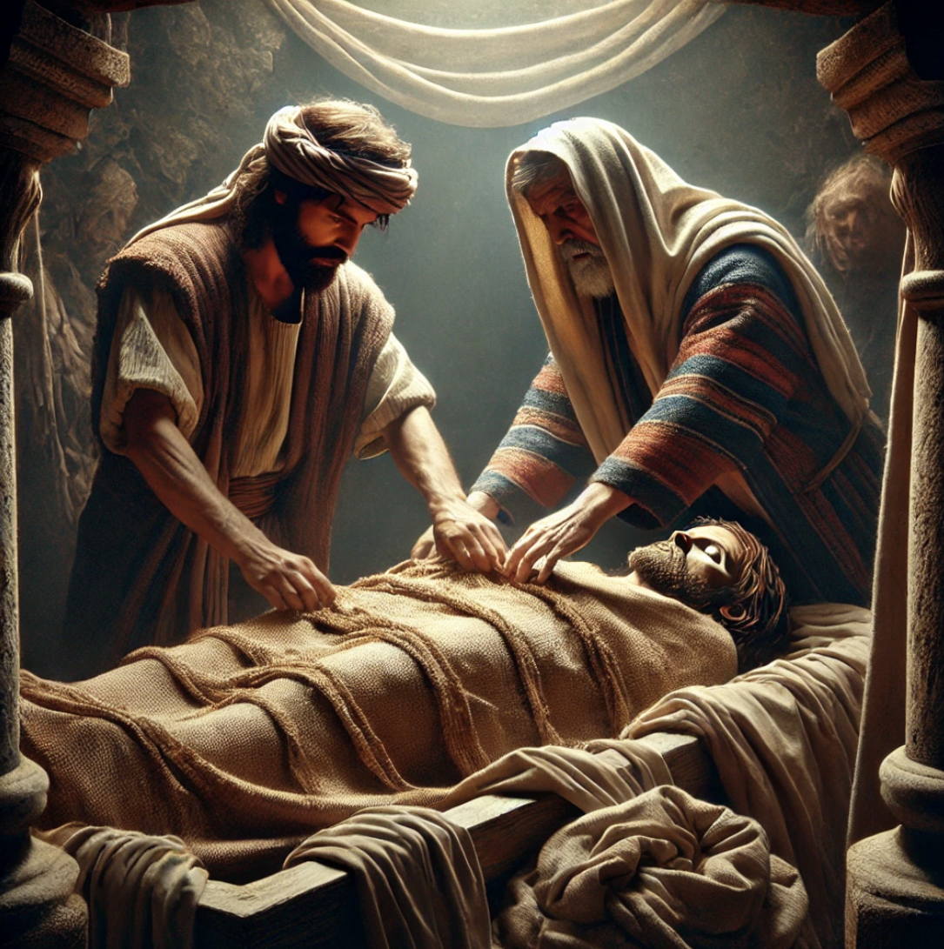
No longer by night
- John 19:40
Then took they the body of Jesus, and wound it in linen clothes with the spices, as the manner of the Jews is to bury.
“Joseph and Nicodemus no longer hid their faith in Christ.” - Desire of Ages, p. 184

Slide 52

No longer by night
- John 19:41
Now in the place where he was crucified there was a garden; and in the garden a new sepulchre, wherein was never man yet laid.
“In love and honor they prepared His body for the tomb.” - Desire of Ages, p. 186

Slide 53
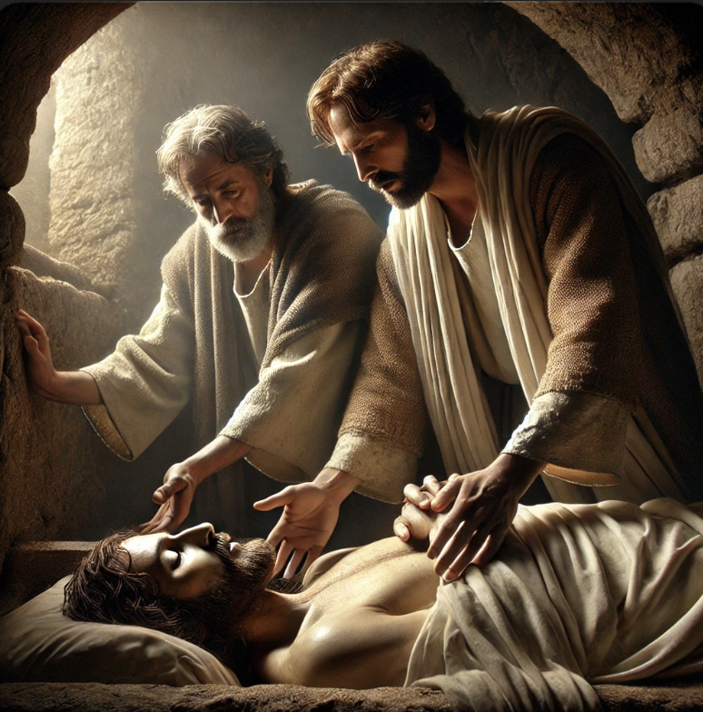
No longer by night
- John 19:42
There laid they Jesus therefore because of the Jews' preparation day; for the sepulchre was nigh at hand.
“Happy are they who are willing for self to be humbled, saying with John the Baptist, "He must increase, but I must decrease."- Desire of Ages, p. 182

Slide 54
Born Again:
The Desire of Ages p. 177
After the Lord's ascension, when the disciples were scattered by persecution, Nicodemus came boldly to the front. He employed his wealth in sustaining the infant church that the Jews had expected to be blotted out at the death of Christ.

Slide 55
Born Again:
The Desire of Ages p. 177
In the time of peril he who had been so cautious and questioning was firm as a rock, encouraging the faith of the disciples, and furnishing means to carry forward the work of the gospel. He was scorned and persecuted by those who had paid him reverence in other days.

Slide 56
Born Again:
The Desire of Ages p. 177
He became poor in this world's goods; yet he faltered not in the faith which had its beginning in that night conference with Jesus.
Nicodemus related to John the story of that interview, and by his pen it was recorded for the instruction of millions.

Slide 57
Born Again:
The Desire of Ages p. 177
The truths there taught are as important today as they were on that solemn night in the shadowy mountain, when the Jewish ruler came to learn the way of life from the lowly Teacher of Galilee.

Slide 58
Thank You!
And HAPPY SABBATH!

